Slide 1
Mobile-Commerce Development
Lesson
Google Firebase Cloud Messaging
Lecturer:
Tran Duy Thanh, Phd
Nguyen Quang Phuc, Msc
Email: thanhtd@uel.edu.vn
Blog: https://tranduythanh.com
Phone: 0987773061

Slide 2
Lesson Objective
Students know advantages of Firebase realtime Database
Create Firebase Account and Firebase realtime Database
Connect Android App to Firebase
Read List from Firebase Realtime Database
Insert Firebase Realtime Database
Read Single data from Firebase Realtime Database
Update Firebase Realtime Database
Delete Firebase Realtime Database
Details of the instruction: https://tranduythanh.com/category/firebase/

Slide 3
Outlines
Introduction Firebase Realtime Database
Connect App to Firebase
Add the Realtime Database to App
Create Realtime Database
Read List Firebase Realtime Database
Insert Firebase Realtime Database
Read Single data Firebase Realtime Database
Update Firebase Realtime Database
Delete Firebase Realtime Database

Slide 4
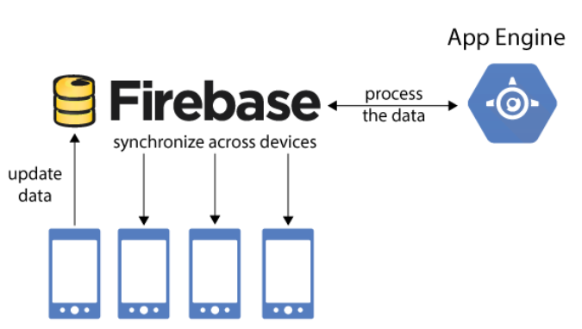
1. Introduction Firebase Realtime Database
The Firebase Realtime Database is a cloud-hosted database. Data is stored as JSON and synchronized in realtime to every connected client. When you build cross-platform apps with our Apple platforms, Android, and JavaScript SDKs, all of your clients share one Realtime Database instance and automatically receive updates with the newest data.
More Reading: https://firebase.google.com/docs/database
https://tranduythanh.com/2018/10/11/phat-trien-ung-dung-co-so-du-lieu-thoi-gian-thuc-voi-firebase-phan-1/
https://tranduythanh.com/2018/10/13/phat-trien-ung-dung-co-so-du-lieu-thoi-gian-thuc-voi-firebase-phan-2/
https://tranduythanh.com/2018/10/15/phat-trien-ung-dung-co-so-du-lieu-thoi-gian-thuc-voi-firebase-phan-3/
https://tranduythanh.com/2018/10/15/phat-trien-ung-dung-co-so-du-lieu-thoi-gian-thuc-voi-firebase-phan-4/
https://tranduythanh.com/2018/10/15/phat-trien-ung-dung-co-so-du-lieu-thoi-gian-thuc-voi-firebase-phan-5/

Slide 5
Discussions
Q1: What are the advantages of Firebase Realtime Database?
Q2: How to create Firebase account?
Q3: How to connect Mobile to Firebase?
Q4: How to Select list data from Firebase Realtime Database?
Q5: How to Single data from Firebase Realtime Database?
Q6: How to Update data for Firebase Realtime Database?
Q7: How to Delete data from Firebase Realtime Database?

Slide 6
Next Lesson
Google Firebase Cloud Messaging

Slide 7
THANK YOU!

